Slide 1
Avian influenza narratives and research
landscapes
Matthew L. Wallace · INGENIO (CSIC-UPV)
Ismael Rafols · INGENIO (CSIC-UPV) · SPRU (University of Sussex)
EU-SPRI Conference Manchester, 19 June 2014

Slide 2
OUTLINE
Objective: Informing science policy decisions by linking policy narratives to the research landscape
Context: avian influenza as a policy and a science policy problem
Main methods
Stakeholder interviews to reveal narratives and values
Characterizing research options through bibliometrics
Preliminary results
Characterizing research landscapes and options
Uncovering diverse worldviews and debates
How stakeholder values relate to the allocation of resources
Possible implications and next steps
Notes:
Question: what do we want to fund? So… What types of solutions, what is the ”supply”? How does it play out in various fora?

Slide 3
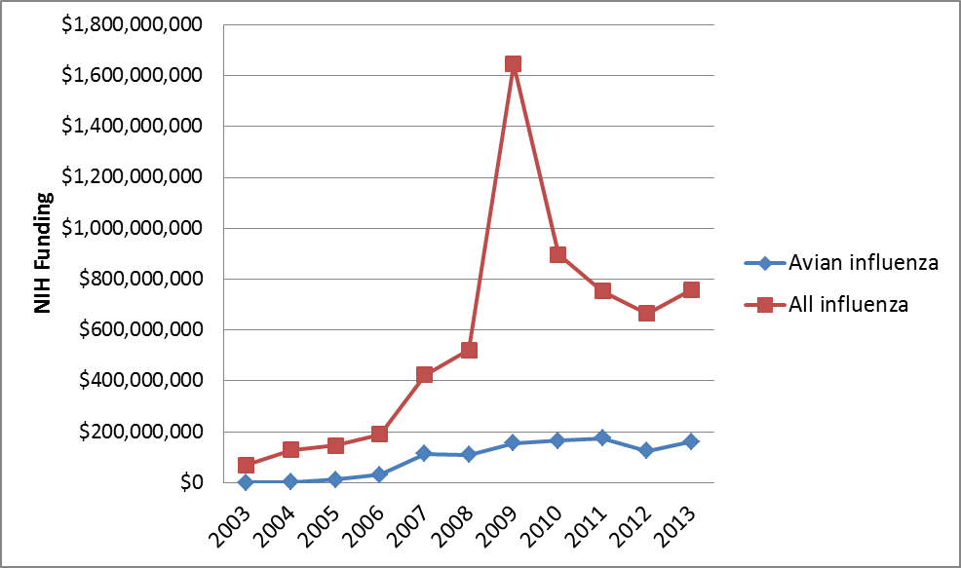
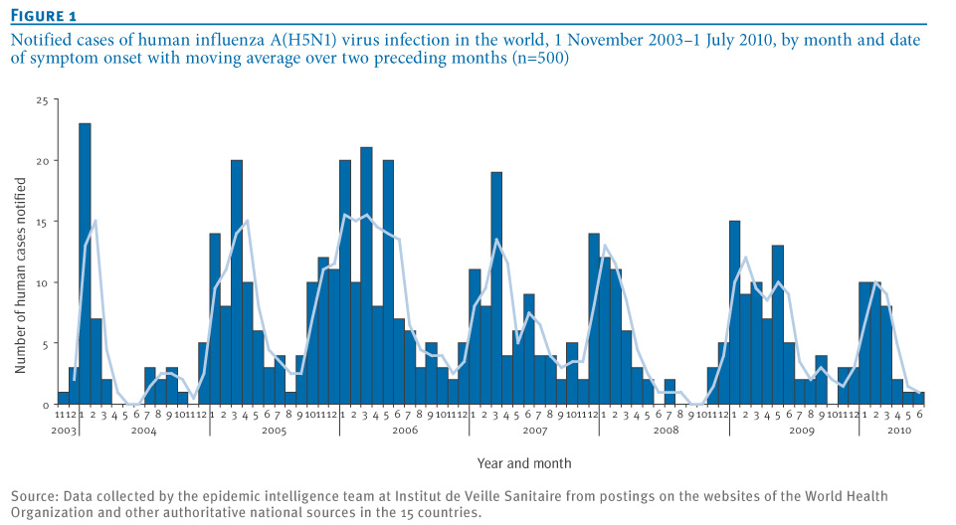
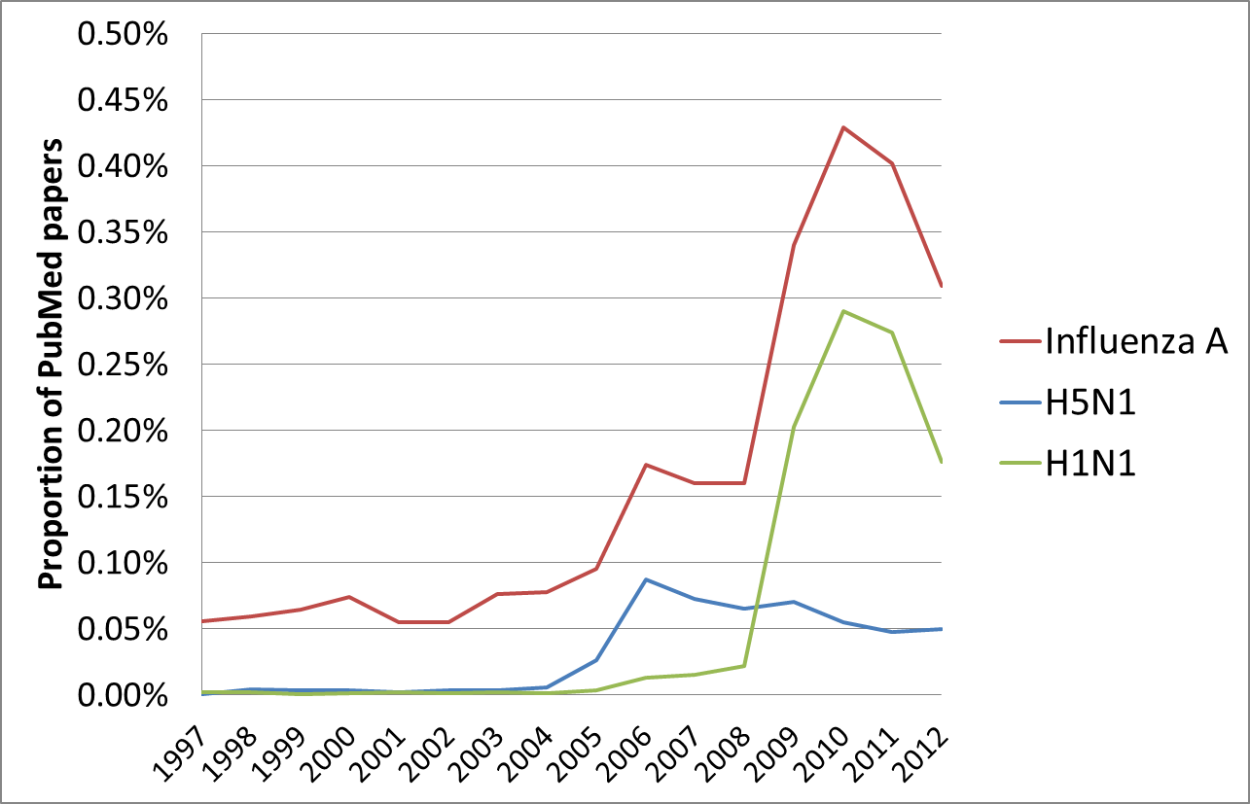
1. CONTEXT
The (re)-emergence of avian flu and research response
Notes:
Research as one of the policy responses

Slide 4
1. CONTEXT
Situating the research question
Avian flu as a complex social, political and scientific problem
Local/global governance issues
High levels of uncertainty (diagnosis, mutations)
Socio-economic vs. “technological” solutions
The science policy aspect has yet to be explored
What values and priorities underlie public sector views of the “research landscape” of avian influenza?
How do research choices and modalities connect with expectations?
Notes:
We already know about some of the narratives in terms of response and governance…

Slide 5
2. METHODS
Bibliometric tools
PubMed delineation and Web of Knowledge records to build a database of publications on avian influenza
Extensive bibliographic information related to publications on specific research objects
Several methods used to map the landscape and “overlay” portfolios
Focus on co-term analysis
Aim for robust mapping and clustering techniques

Slide 6
2. METHODS
Eliciting broad stakeholder views and narratives
15 semi-structured, in-person interviews
Target high-level perspectives from senior scientists, managers, policymakers in public sector
Seek diversity in terms of 1) technical knowledge, 2) policy relevance, 3) political agenda
Elicit narratives and views of research and outcomes
University lab
National lab
Technical
Regulatory agency
National funding agency
Nat’l /int’l public health policy org
Policy
NGO / lobby groups
Notes:
Top-down and bottom-up

Slide 7
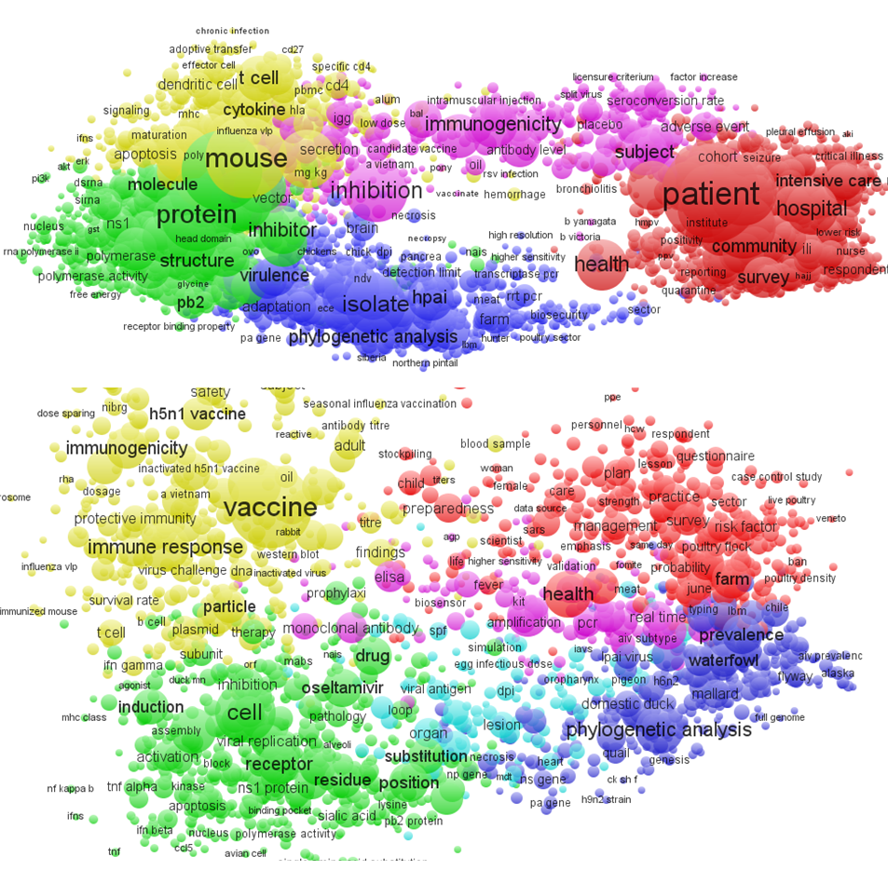
3. PRELIMINARY RESULTS
A long-term, multi-scale view of the landscape
VACCINE DEVELOPMENT
DIAGNOSIS / DETECTION
EPIDEMIOLOGY
IMMUNITY AND TREATMENT
EVOLUTION AND GENETICS
PATHOLOGY
Avian influenza research terms, 2004-2013

Slide 8
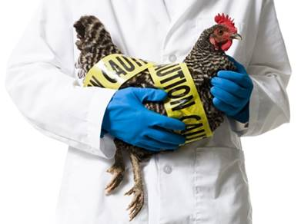
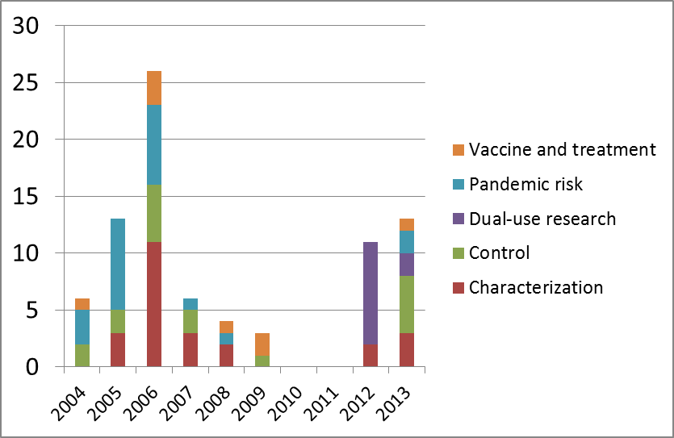
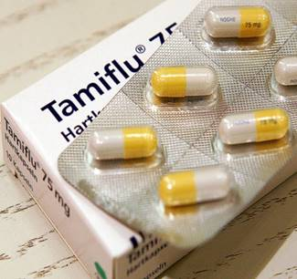
3. PRELIMINARY RESULTS
Public and scientific debates
Figure 4. Number of editorials in leading journals, sorted according to main topic of concern.
The Independent, June 11, 2014
Notes:
Science policy, political, and more technical issues explored through editorials

Slide 9
3. Preliminary results
Contrasting stakeholder perspectives
Narrow or broad view of research landscape (set of all avian influenza research conducted)
Various dichotomous views on research options
Animal vs. human
Lab-based vs. field-based
Many barriers to rapid, high-quality solutions
Regulatory hurdles
Financial incentives
Publishing pressures
Agreement on basic research needs and some trade-offs
Long-term vs. short-term benefits
Collaboration and coordination requirements
Diverse views of influenza “risk”
Narrow or broad view of societal outcomes
Descriptions
Norms and values
Notes:
What does the landscape look like?
Agreement on basic research
Why is it like this?

Slide 10
3. PRELIMINARY RESULTS
Making links to publications
Avian influenza “base map”, 2009-2013
Notes:
See the dichotomous views of animal/human, lab-based vs. on the ground --- put some lines
Not everyone is funding the same thing, but it’s not always straightforward why…

Slide 11
PRELIMINARY RESULTS
Mapping outcomes and research (indirectly)?
Institutional imperatives
International coordination
National health
Scientific “excellence”
…
Areas of research
Evolution and genetics
Pathology
Epidemiology
Immunity and treatment
Vaccine development
Diagnosis and detection
Specific outcomes
Pandemic risk reduction
Livelihoods
Pandemic preparedness
Reduced mortality/morbidity
…
Debates
Dual-use research
Characterization
Control measures
Vaccine and treatment
Pandemic risk
Notes:
Can’t map things directly

Slide 12
CONTRIBUTIONS AND NEXT STEPS
Informing allocation of public funding to avian flu priorities?
Linking research options to outcomes/solutions is ambiguous
Variety of opinions on the “supply” and “demand” side related to institutional positions and actors’ values
What else?
Landscapes as a useful heuristic to elicit and interpret views, but not to be taken for granted
Influenza lends itself to different frames
What’s next?
In-depth analysis of interview data
Generalizing the approach to other cases?
Notes:
Divering opinions of different
Technological trajectories... Especially for flu!
This is a pilot study…

Slide 13
THANK YOU
INGENIO [CSIC-UPV] Ciudad Politécnica de la Innovación | Edif 8E 4º Camino de Vera s/n
46022 Valencia
tel +34 963 877 048
fax +34 963 877 991

